Slide 1

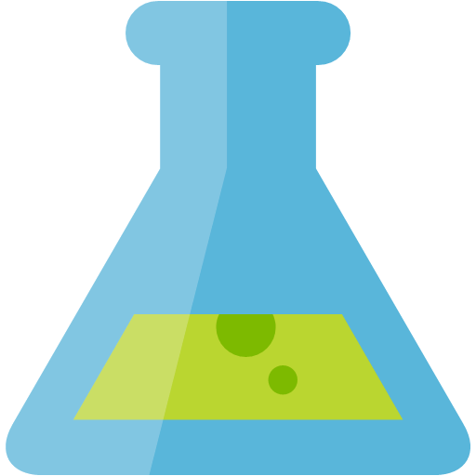



Lab Architecture – June 2020
MODEL TRAINING
MODEL MANAGEMENT
AUTO ML
Track Runs & Register Models
Azure Machine Learning Workspace
Register Automated Machine Learning Model
Azure Machine Learning Compute
Azure Databricks (PyTorch & Keras)
INGEST
LONG TERM STORAGE
STREAM DATA PROCESSING
Retrieve Model
IoT Hub or Event Hubs
Azure Storage
Battery Telemetry
Azure Databricks (Spark Structured Streaming)
Simulated Data Stream
(NOTE: not used in the lab)
(NOTE: a CSV file of previously captured streaming data is provided to expedite setup)
BATCH DATA PROCESSING
Component Text
Azure Databricks (Spark DataFrames)

Slide 2



Preferred Solution – September 2020
DATA PREPARATION
MODEL TRAINING
MODEL MANAGEMENT
AUTO ML
Track Runs & Register Models
Azure Machine Learning Workspace
Register Automated Machine Learning Model
Azure Machine Learning Compute
Azure Databricks
Data Cleansing and Preparation
Model Training (PyTorch & Keras)
Deploy models
REAL-TIME INFERENCING
INGEST
LONG TERM STORAGE
Azure
Kubernetes
Service
Historical data
Retrieve Model
(NOTE: AKS is the production-grade choice for deploying models used in real-time inferencing. To expedite setup time and optimize costs, the lab is using ACI - Azure Container Instances - for model deployment, which is only recommended for dev/test scenarios.)
STREAM DATA PROCESSING
IoT Hub
Batch write messages to storage endpoint
Azure Blob Storage
Battery Telemetry
(NOTE: not used in the lab)
(NOTE: a CSV file of previously captured streaming data is provided to expedite setup)
Azure Databricks (Spark Structured Streaming)
BATCH DATA PROCESSING
Simulated Data Stream
PDF Forms
Knowledge Mining
Forms Recognizer
Component Text
Azure Databricks (Spark DataFrames)
Anomaly Detection
Metrics Advisor
Conversational AI

